Slide 1
Basic Graphics Concepts
Day One
CSCI 440

Slide 2
Terminology
object - the thing being modeled
image - view of object(s) on the screen
frame buffer - memory that contains the pixels
for each pixel, we need red, green, blue, and depth.
located on the GPU
transformation - translate, rotate, scale
clipping - deciding which part of the world to view
projection- converting from 3d to 2d
rasterization - display the pixels on the screen

Slide 3
Graphic Elements
Objects
points are specified in model coordinates
Viewer
where the viewer is standing and direction of sight
how much of the world can be seen
Lighting
ambient, direct, colored, etc
Material Properties
color, shiny-ness, pattern, …

Slide 4
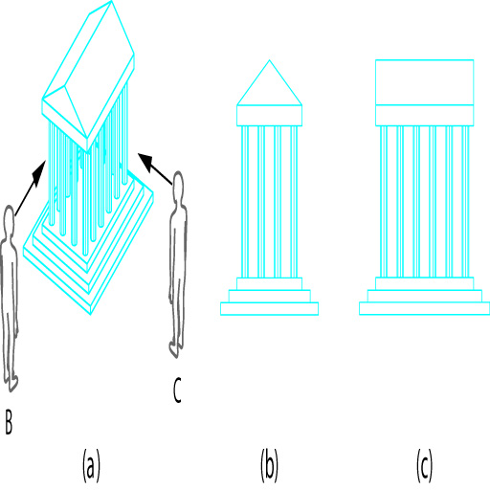
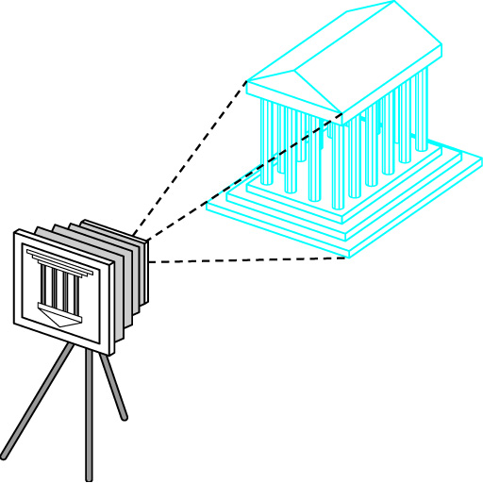
Viewing
it's all math
a model is just numbers
transformation and viewing are just simple linear algebra
Angel - figures 1.6 and 1.7

Slide 5
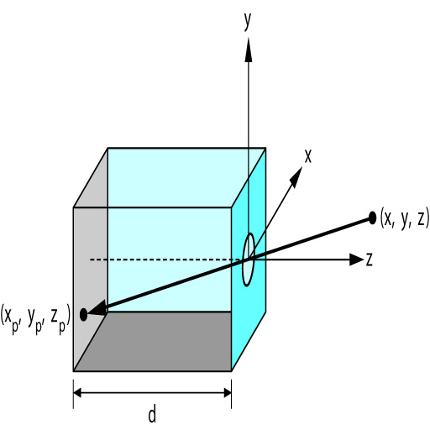
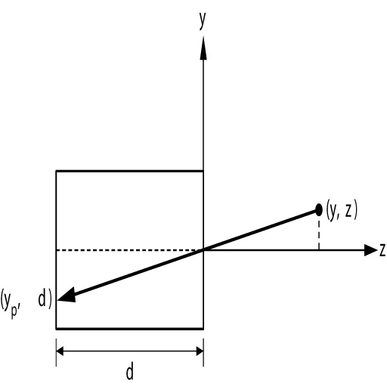
The Pinhole Camera
y
y_{p} = -------
z / d
Angel - figures 1.12 and 1.13

Slide 6
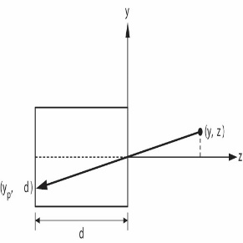
Pinhole Camera
y
y
y_{p} = -------
z / d
d = 10
A = [ 25, 15, 10 ]
B = [ 25, 25, 10 ]
C = [ 25, 15, 25 ]
A_{p} = [ 25, 15 ]
B_{p} = [ 25, 25 ]
C_{p} = [ 10, 6 ]
x
x
x_{p} = -------
z / d
Q : Where is A_{p} when d=20?
A : [ 50, 30 ]

Slide 7
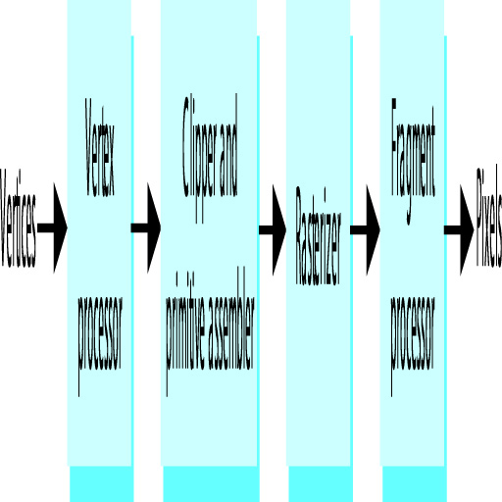
Graphics Processing
Vertex Processing
transformations
4x4 matrix multiplication
input and output is 3D points
Angel - figure 1.31
Notes:
we need to keep 3D information as long as possible, eg hidden surface removal is done later

Slide 8
Graphics Processing
Clipping and Primitive Assembly
use a pyramid shaped clipping volume to reduce the amount of data we need to process
output is the primitives (lines, triangles, points) that need to be drawn on the screen

Slide 9
Graphics Processing
Rasterization
output is color, location and depth of potential pixels
Fragment Processing
blend pixels, apply textures, etc.

Slide 10
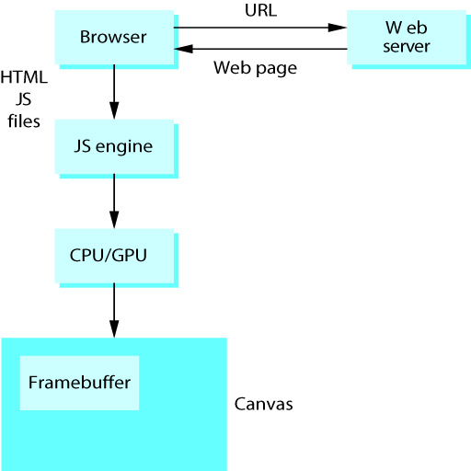
WebGL
Angel - figure 2.4

Slide 11
next classes
Quick Tutorial on HTML and JavaScript
A simple WebGL program

